Slide 1
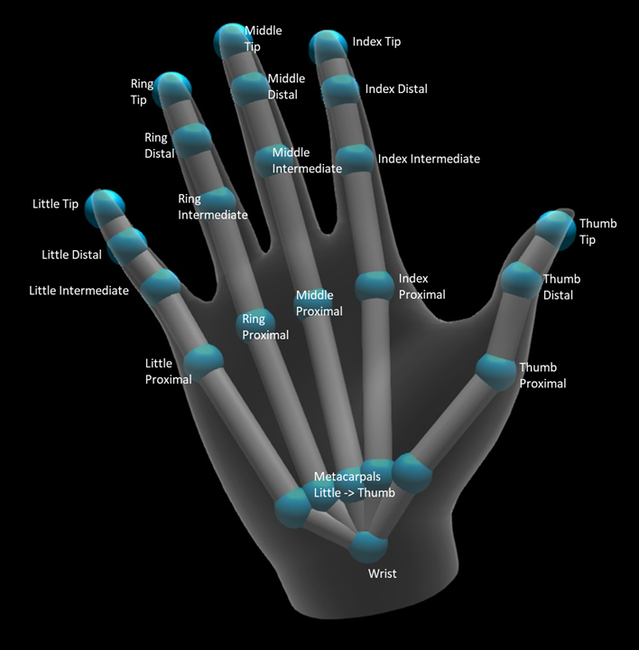
AI Sign Language with Python
Hand Sign Detection
Team Members
Ahmed Atef
Ahmed Abobakr
Alzahraa Waled
Ganna Ayman
Mona Essam
DSP//EE207
Submitted to Prof/Dr.Abdullah Al-Ramsisi

Slide 2
Content
Introduction
Objective
Used Technology
Model Training (CNN)
System Results , Testing
Error
Project accurate or not accurate
Problems faced and its solution

Slide 3
Introduction
AI Hand Sign Detection is a field within artificial intelligence (AI) and computer vision that focuses on developing systems capable of recognizing and interpreting hand gestures or signs made by individuals. The goal is to enable machines to understand and respond to human communication through hand movements, providing a more intuitive and natural interaction between humans and computers.

Slide 4

Objective
Accessibility Tools:
AI hand sign detection can be integrated into accessibility tools to assist individuals with motor disabilities. It provides an alternative and intuitive means of controlling devices or communicating for those who may have limited mobility.

Slide 5
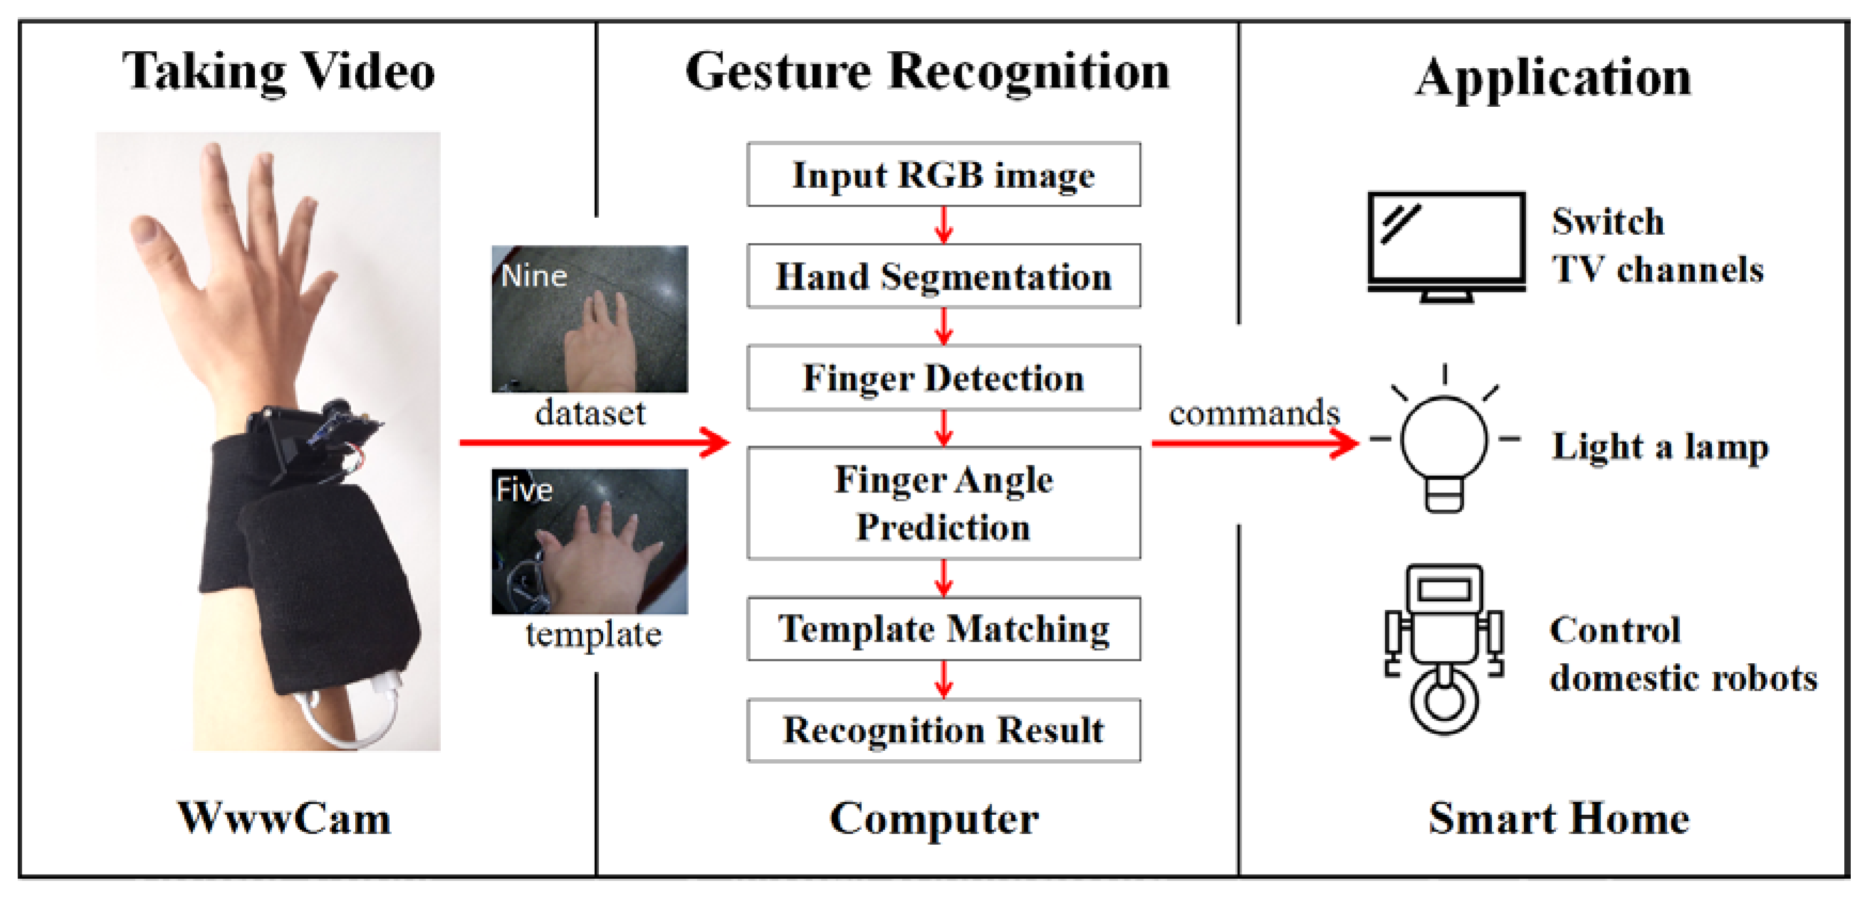
Security and Surveillance:
Hand sign detection can be employed in security and surveillance systems for recognizing specific hand gestures as commands or alerts. This can be useful in public spaces, transportation, and critical infrastructure.

Slide 6
Used technology
Where there is
Controller is PC
Sensor is the Camera
Input is image and Output is an image with the word that was defined
Machine learning algorithms, including deep neural networks, are often used to classify and recognize different hand gestures based on training data.
Trained models, such as convolutional neural networks (CNNs), are employed to analyze and classify images of hands into predefined categories.
By enabling machines to understand and respond to hand signals, users can interact with devices and systems in a more natural and intuitive manner.

Slide 7
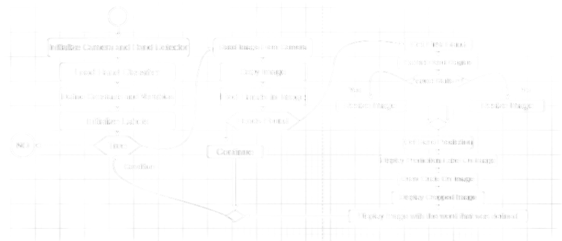
Chart Digram

Slide 8
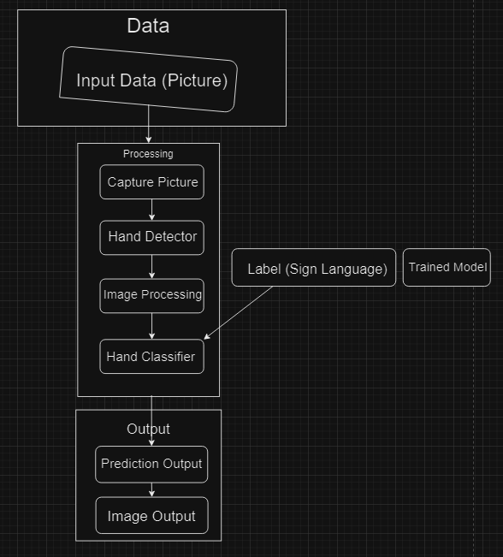
Block Digram

Slide 9
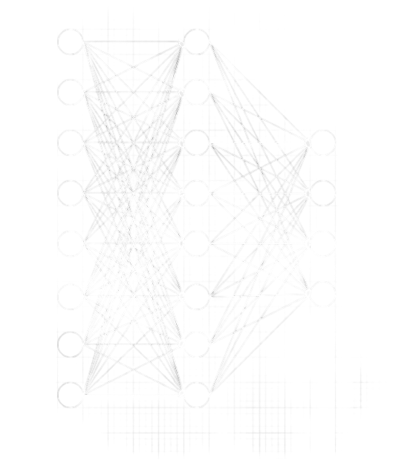
Convolution Neural Network(CNN)

Slide 10
Convolution Neural Network(CNN)
Image recognition and tasks that involve the processing of pixel data.
A deep learning CNN consists of three layers: a convolutional layer, a pooling layer and a fully connected (FC) layer. The convolutional layer is the first layer while the FC layer is the last.
In the previous slide there is a picture that expresses ( 8 Inputs Image , 8 Hidden layer to do trained model , 4 Output for each one there are two probabilities come out image with the word that was defined.

Slide 11
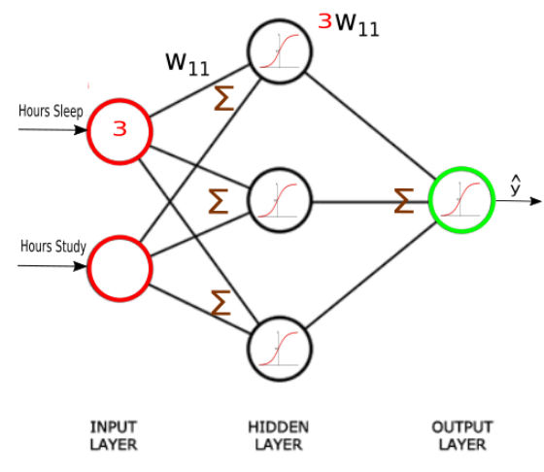
Convolution Neural Network(CNN)
A training model is created by enter many images for each class, and the weight of the solid line is calculated from one neural to another . This weight is constant after calculate it
When a different image is entered, it is dealt with and the result is produced . This is done by multiplying the image’s attribute by the weight and summing them.

Slide 12
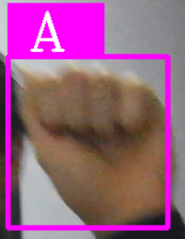
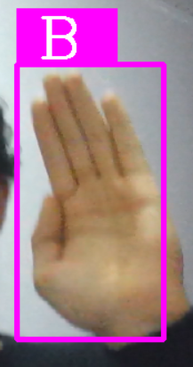
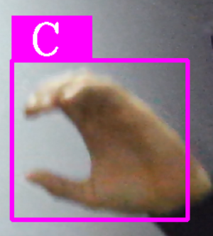
System Results , Testing
For class (A) For class (B) For class (c)

Slide 13
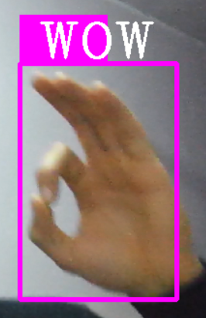
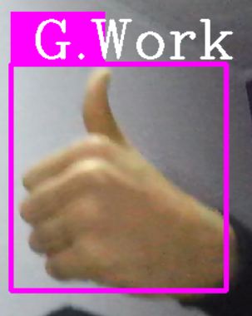
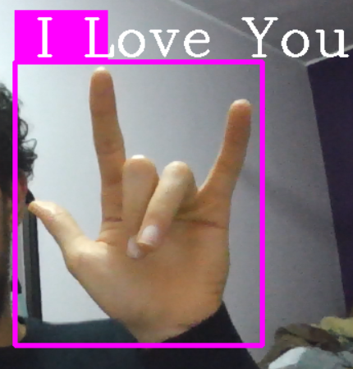
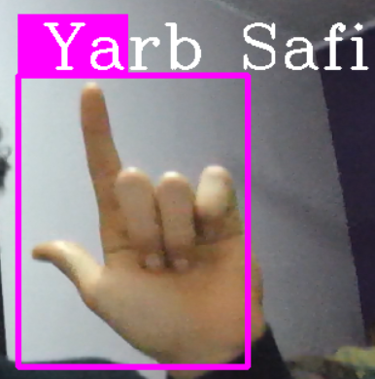
System Results , Testing
For class (WOW) For class (G.Work) For class (I Love You) For class(Yarb Safi)

Slide 14
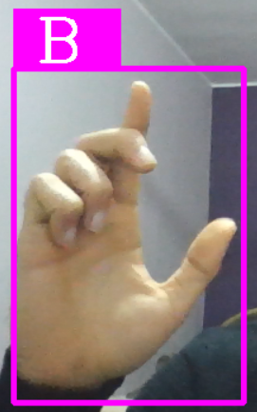
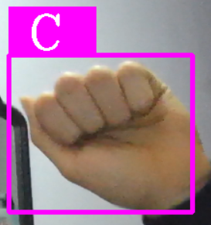
Error
An error occurred in some classes due to changing the angles of obtaining the image, so the image was not recognized in label model (trained model)
Like class (A) but error out is class (C) and class (B) but error out is class(yarb)

Slide 15
Project accurate or not accurate
When entering a lot of pictures from most angles for each class, an error occurred in some of them, and the percentage of error is 85%
So the project is Accurate

Slide 16
Problems
There were some problems in the code regarding my Python libraries
How we solve it
It was solved by obtaining old Python libraries and modifying them
Libraries:
Opencv
Cvzone
Tensorflow
Numpy
Math

Slide 17
Thank You

